Slide 1


V1OSX
V1 OPERATING SYSTEM TEN
The operating system
beneath the revival.
STAFF VISION + OPERATING BLUEPRINT
Notes:
[Sources]
- https://v1.church/ - official V1 logo, live coral color, typography and photography reference.

Slide 2
Nothing is wrong.
That is precisely why this is the right time.
V1OSX
Notes:
[Sources]
- V1OSX Founder-approved operating direction, August 2026.

Slide 3
WHY NOW
Systems that carried one season
can become ceilings in the next.
We are not reconstructing V1 because it is broken. We are strengthening the systems beneath it because God has entrusted us with more.
Closer vision
Deeper development
Real shepherding
Repeatable ministry
V1OSX
03
Notes:
[Sources]
- V1OSX Founder-approved operating direction, August 2026.

Slide 4

V1OSX
One house. One voice. Many leaders.
Unmistakable ownership.
NOT MORE BUREAUCRACY. THE END OF AVOIDABLE AMBIGUITY.
Notes:
[Sources]
- V1OSX Founder-approved operating direction, August 2026.

Slide 5
THE ARCHITECTURE
Ten systems. One operating language.
01
WING Leadership
06
All-In Experiences
02
Signorelli Leadership System
07
Outside Income + Enterprise
03
V1 Global Online
08
The Sunday Experience
04
Pulpit + Preaching Rhythm
09
Weekly Chapel
05
V1 Ambassador Pathway
10
Marriage + Relationships
V1OSX
05
Notes:
[Sources]
- V1OSX Founder-approved operating direction, August 2026.

Slide 6
01
WING Leadership
Vision should travel at the speed of trust.
V1 OPERATING SYSTEM TEN
01

Slide 7
DIRECT ACCESS. DISTRIBUTED CLARITY.
The Lead Pastor meets the department.
Pastor
Next Steps
Production
Operations
LEAD
PASTOR
Worship
V1X
Media
Missions
Kids
Men of Valor
Youth
Two WING members live inside every department and carry voice, vision and values between meetings.
Free Women
01 / WING LEADERSHIP
07
Notes:
[Sources]
- /Users/mikesignorelli/Desktop/V1OSX/Structure for VI.pdf
- /Users/mikesignorelli/Downloads/V1_Church_Staff_by_Department.pdf

Slide 8
LEAD PASTOR CALENDAR
6
hours per week
Twelve departments. Each department meets with the Lead Pastor twice every month.
WEEK ONE
WEEK TWO
6 department meetings
6 department meetings
Meetings may finish early. They never exceed one hour.
01 / WING LEADERSHIP
08
Notes:
[Sources]
- V1OSX Founder-approved operating direction, August 2026.

Slide 9
THE OPERATING RHYTHM
WING keeps the work moving between meetings.
W
Watch
over department health
UP TO 60 MINUTES
I
Interpret
and clarify vision
10
Wins, people + health
15
Scorecard + realities
N
Navigate
questions and next steps
20
Vision, decisions + obstacles
G
10
Owners + deadlines
Guard
alignment, culture and momentum
05
Culture, story + prayer
Decision record distributed within 24 hours.
01 / WING LEADERSHIP
09
Notes:
[Sources]
- /Users/mikesignorelli/Desktop/V1OSX/Structure for VI.pdf

Slide 10

02
The Signorelli
Leadership System
Built to launch the whole person toward their destination.
NASA'S SPACE LAUNCH SYSTEM
The only rocket that can send Orion, four astronauts and large cargo directly to the Moon in a single launch.
V1 OPERATING SYSTEM TEN
02
Notes:
[Sources]
- NASA Space Launch System: https://www.nasa.gov/reference/space-launch-system/

Slide 11
NOT TWELVE MONTHLY LESSONS
A four-stage transformation launch.
01
02
03
04
REVEAL
REGULATE
REBUILD
REPRODUCE
See what is true
Lead the inner world
Operate with clarity
Multiply capacity
REVEAL > REGULATE > REBUILD > REPRODUCE
02 / SLS
11
Notes:
[Sources]
- Gallup: https://www.gallup.com/workplace/712895/leaders-improve-employee-engagement-company-culture.aspx
- Center for Creative Leadership: https://www.ccl.org/leadership-solutions/leadership-topics/self-awareness-training-leadership/

Slide 12
01
Reveal
“
I understand how I am wired, where I am strong, and what is currently limiting me.
SLS Leadership MRI
Spiritual + emotional health scan
Personal-history interview
Role-effectiveness review
Strengths analysis
360 input
Pressure + derailer profile
90-minute debrief + annual breakthrough
02 / SLS
12
Notes:
[Sources]
- SLS Founder-approved framework, August 2026.

Slide 13
02
Regulate
“
I can lead my inner world rather than being unconsciously driven by it.
Emotional activation
Family-of-origin patterns
Offense, fear + shame
Boundaries + forgiveness
Nervous-system awareness
Spiritual freedom
Thought patterns
Recovery practices + referral when warranted
Practical regulation and self-awareness - never therapy or clinical diagnosis.
02 / SLS
13
Notes:
[Sources]
- SLS Founder-approved framework, August 2026.

Slide 14
03
Rebuild
“
I operate with greater clarity, discipline, relational skill, and effectiveness.
Role clarity
Conflict + ownership
Priority architecture
Habits + delegation
Communication
Energy + execution
Decision-making
Difficult-conversation labs
02 / SLS
14
Notes:
[Sources]
- SLS Founder-approved framework, August 2026.

Slide 15
04
Reproduce
“
My development now increases the capacity of other people.
Coaching
Delegation
Encouragement
Identifying potential
Correction
Developing successors
Discipleship
Culture-carrying + multiplication
02 / SLS
15
Notes:
[Sources]
- SLS Founder-approved framework, August 2026.

Slide 16
THE CADENCE
Intensive enough to reveal.
Practical enough to use today.
4
8
5-15
LIVE
90-minute intensives
coaching sessions
weekly minutes
leadership labs
major reveals + breakthroughs
implementation + live obstacles
one reflection, action or conversation
apply the tool to an actual problem
Every session solves something the participant already cares about.
02 / SLS
16
Notes:
[Sources]
- SLS Founder-approved framework, August 2026.

Slide 17
“
Every person carrying this vision receives elite development.
CONFIDENTIAL
Vulnerability is not automatically a performance record.
PERSONAL
A 55-year-old executive and a 22-year-old coordinator do not receive the same path.
IMMEDIATE
The first two sessions produce a meaningful win.
REVELATORY
Accurate discovery creates language, clarity and momentum.
Not remedial. Not generic. Not theoretical.
02 / SLS
17
Notes:
[Sources]
- SLS Founder-approved framework, August 2026.

Slide 18
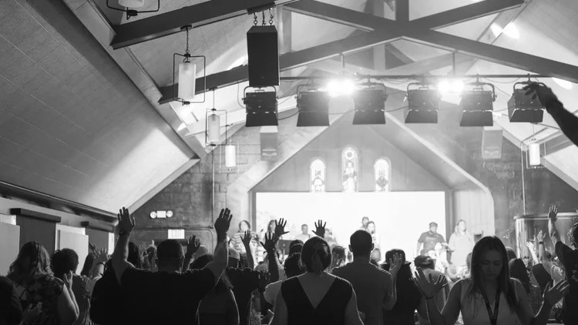
03
V1 Global Online
Not an audience.
A congregation.
Streaming can gather an audience. Shepherding forms a congregation.
Notes:
[Sources]
- https://v1.church/ - V1 photography.
- /Users/mikesignorelli/Downloads/V1 Church Global Regional Shepherding Model.pdf

Slide 19
WHAT THE LAST SEASON TAUGHT US
Engagement increased.
Giving fell when shepherding disappeared.
ENGAGEMENT
GIVING
INCREASED
-50%
More people were engaging online.
When pastoral care was removed.
V1 internal historical observation
03 / V1 GLOBAL ONLINE
19
Notes:
[Sources]
- Founder-supplied V1 internal observation, August 2026.
- Pew online religious services: https://www.pewresearch.org/religion/2023/06/02/online-religious-services-appeal-to-many-americans-but-going-in-person-remains-more-popular/

Slide 20
A CONGREGATION WITHOUT GEOGRAPHIC WALLS
No one uncovered.
10
4
240
1,040
pastors
hours weekly each
weekly touchpoints
monthly maximum
AMERICAS
CENTRAL
AMERICAS
EAST + ATLANTIC
AMERICAS
WEST
CANADA
UK +
EUROPE
EMERGING
REGIONS
Indiana serves as the secondary online ministry hub. Revival Homes receive real pastoral covering.
03 / V1 GLOBAL ONLINE
20
Notes:
[Sources]
- /Users/mikesignorelli/Downloads/V1 Church Global Regional Shepherding Model.pdf

Slide 21
THE METRICS THAT DESCRIBE A CHURCH
Views tell us reach.
These tell us belonging.
01
Pastoral coverage
06
Baptisms
02
Response time
07
Serving
03
Touchpoints
08
Retention
04
Next steps
09
Generosity
05
Groups + Revival Homes
10
Transformation stories
03 / V1 GLOBAL ONLINE
21
Notes:
[Sources]
- Pew online religious services: https://www.pewresearch.org/religion/2023/06/02/online-religious-services-appeal-to-many-americans-but-going-in-person-remains-more-popular/
- Barna church technology and mission: https://www.barna.com/research/church-technology-mission/

Slide 22
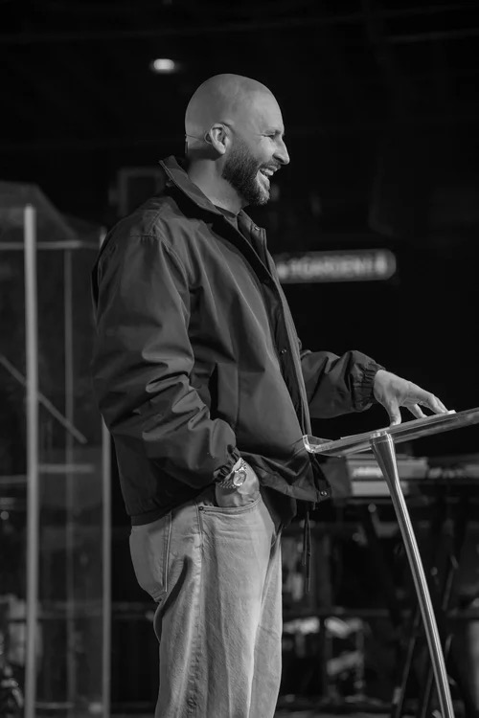
04
The Pulpit +
Preaching Rhythm
One house needs a clear word.
The lead teaching gift equips many other gifts.
Notes:
[Sources]
- https://v1.church/ - V1 photography.

Slide 23
ANNUAL HEALTHY RHYTHM
38-40 Sundays carry the Lead Pastor's voice.
38-40
10-12
Lead Pastor
guests + national communicators
04 / PULPIT + PREACHING
23
Notes:
[Sources]
- Founder-approved Annual Healthy Rhythm, August 2026.

Slide 24
V1'S OWN HISTORY
The pattern points in one direction.
V1 internal historical observation
>70%
average annual growth
>30%
Lead Pastor preached
38-40 Sundays
decline in attendance + giving
Lead Pastor preached
two times monthly or fewer
04 / PULPIT + PREACHING
24
Notes:
[Sources]
- Founder-supplied V1 internal historical observation, August 2026.

Slide 25
THE ASSIGNMENT IS BOTH BIBLICAL AND OBSERVABLE
72%
71%
of large churches reported that their most dramatic growth occurred under the current senior leader.
of regular Protestant attenders said valuable sermons were a very important reason they attend.
ACTS 6:4
1 TIMOTHY 5:17
EPHESIANS 4:11-12
Prayer + ministry of the Word
Laboring in preaching + teaching
Equipping the saints for ministry
04 / PULPIT + PREACHING
25
Notes:
[Sources]
- Hartford Institute Megachurch Resurgence 2026: https://hirr.hartfordinternational.edu/wp-content/uploads/2026/06/Megachurch-Resurgence.pdf
- Pew reasons for attending: https://www.pewresearch.org/religion/2018/08/01/why-americans-go-to-religious-services/

Slide 26
“
This is not a verdict on who is called to preach.
It is a decision about where each voice creates the greatest Kingdom return.
WEEKLY
2-3 TIMES A YEAR
300
TENS OF THOUSANDS
Repetition can build depth.
Because of the significance of the pulpit.
The Sunday pulpit is not the only classroom in an apostolic house.
Your development is not being reduced. Your platform is being expanded beyond one definition of preaching.
04 / PULPIT + PREACHING
26
Notes:
[Sources]
- V1OSX Founder-approved operating direction, August 2026.

Slide 27
05
The V1 Ambassador
Pathway
The invitation may name one person. The sending belongs to the house.
V1 OPERATING SYSTEM TEN
05

Slide 28
NOT CONTROL. COVERING, STEWARDSHIP + SUPPORT.
Every invitation passes through five questions.
01
ALIGNMENT
Do doctrine, ethics and reputation align?
02
ASSIGNMENT
Why this person? What Kingdom purpose?
03
AVAILABILITY
Can V1 responsibilities remain strong?
04
ACCOUNTABILITY
Are honorarium, travel and rights clear?
05
AMPLIFICATION
How can V1 support the assignment?
05 / V1 AMBASSADOR PATHWAY
28
Notes:
[Sources]
- V1OSX Founder-approved operating direction, August 2026.

Slide 29
A HEALTHY SENDING PROCESS
Approved. Covered. Supported. Sent.
01
02
03
04
05
06
SUBMIT
COVERAGE
REVIEW
APPROVE
SEND
REPORT
Normally 45 days ahead
WING confirms continuity
Operations + pastoral authority
Lead Pastor for high-visibility or Sunday absence
Prayer, people, content or resources
Fruit + relationships captured
External Sunday absences count toward the three-Sunday maximum. A V1-sponsored deployment may receive a written strategic exception.
05 / V1 AMBASSADOR PATHWAY
29
Notes:
[Sources]
- /Users/mikesignorelli/Downloads/05 — Staff Handbook and HR Policies/V1 Church Staff Handbook 2024.pdf

Slide 30
06
All-In Experiences
We do not attend everything. We converge on what defines us.
V1 OPERATING SYSTEM TEN
06

Slide 31
RARE MOMENTS DESERVE FULL PRESENCE
All-in does not mean exhausted.
It means that when the moments arrive that define our house, the house shows up.
TIER ONE
HOUSE-DEFINING
All full-time staff attend and serve as assigned. Part-time staff participate by role, availability and need.
TIER TWO
DEPARTMENT + CAMPUS
Responsible departments, campus staff and named support teams converge.
TIER THREE
RECURRING + INVITATIONAL
Participation is encouraged or role-specific - not a blanket expectation.
We arrive with an assignment, a campus, a team and a shared conviction that everyone contributes.
06 / ALL-IN EXPERIENCES
31
Notes:
[Sources]
- V1OSX Founder-approved operating direction, August 2026.

Slide 32
07
Outside Income +
Enterprise
Open hands. Clear lines.
V1 OPERATING SYSTEM TEN
07

Slide 33
PROSPER. CREATE. BUILD. PROTECT THE HOUSE.
Private enterprise passes four protections.
01
ROLE
Performance, energy and availability remain strong.
02
PEOPLE
Spiritual authority is never used for private gain.
03
PROPERTY
V1 brand, data, facilities and time require agreement.
04
PORTFOLIO
No competition or confusion with V1 initiatives.
8.8 million Americans held multiple jobs in 2025. V1's answer is disclosure, discernment and written alignment.
07 / OUTSIDE INCOME + ENTERPRISE
33
Notes:
[Sources]
- BLS multiple jobholders: https://www.bls.gov/cps/cpsaat36.htm

Slide 34
A SIMPLE DECISION LANGUAGE
Disclose. Review. Protect.
GREEN
Unrelated work, passive investments, no V1 people or resources.
DISCLOSE
YELLOW
Ministry-adjacent, public-facing or enhanced by V1 visibility.
REVIEW + DOCUMENT
RED
Congregant solicitation, list use, competing initiatives or role interference.
NOT PERMITTED
07 / OUTSIDE INCOME + ENTERPRISE
34
Notes:
[Sources]
- V1OSX Founder-approved operating direction, August 2026.

Slide 35
Calling is more than a marketplace transaction.
A career may offer
Calling adds
COMPENSATION + STABILITY
PURPOSE + ETERNAL SIGNIFICANCE
V1 pursues fair, sustainable employment. Ministry also includes sacrifice, transformed lives and Kingdom fruit.
The work will matter.
07 / OUTSIDE INCOME + ENTERPRISE
35
Notes:
[Sources]
- V1OSX Founder-approved operating direction, August 2026.

Slide 36
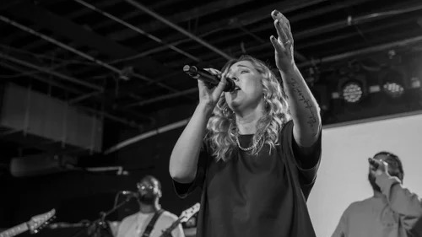
08
The Sunday Experience
Spirit-led. System-supported.
Designed for participation.
ONE SEQUENCE. EVERY WEEK. INDEFINITELY.
Notes:
[Sources]
- https://v1.church/ - V1 photography.

Slide 37
ONE ORDER REMOVES THE NEED TO ASK
Arrive. Belong. Encounter. Participate.
01
ARRIVE + BELONG
Pre-roll / post-roll video + static announcements
Culture video countdown + mission / vision voiceover
Song 1 - V1 Kids and workers worship up front with adults
02
ENCOUNTER + PARTICIPATE
Song 2 - monthly baptisms picture-in-picture
Prayer & Praise - band remains up; collective tongues + named prayer requests
Song 3 - baptisms picture-in-picture + weekly communion stations
Welcome guests after Prayer & Praise
08 / THE SUNDAY EXPERIENCE
37
Notes:
[Sources]
- V1OSX Founder-approved operating direction, August 2026.

Slide 38
THE SEQUENCE CONTINUES
03
RECEIVE + RESPOND
Campus birthday slides + return-to-seat timer - no minute mingle
Pastoral welcome
Offering message - giving slide remains visible - keys only
Sermon
V1TV video announcements
Altar call or sing out
Testimony video ends announcements every week
04
GO + INVITE
Campus Pastor dismissal - New Here - next steps - invite cards - post-roll video
The service does not end when people leave. It becomes mission.
08 / THE SUNDAY EXPERIENCE
38
Notes:
[Sources]
- V1OSX Founder-approved operating direction, August 2026.

Slide 39
09
Weekly Chapel
Sunday gives us the Word. Chapel teaches us how to lead it.
V1 OPERATING SYSTEM TEN
09

Slide 40
A 30-MINUTE BRIDGE FROM REVELATION TO LEADERSHIP
One sermon. One leadership application. One week to live it.
3
5
5
10
5
2
ARRIVE
WORSHIP + PRAYER
LEADERSHIP DEVOTIONAL
APPLICATION + DISCUSSION
COMMITMENTS
+ PRAYER
ASSIGN
+ CLOSE
Primarily staff formation. Open to congregation members and leaders at permanent-install campuses.
Midweek connection without another large evening program.
09 / WEEKLY CHAPEL
40
Notes:
[Sources]
- V1OSX Founder-approved operating direction, August 2026.

Slide 41
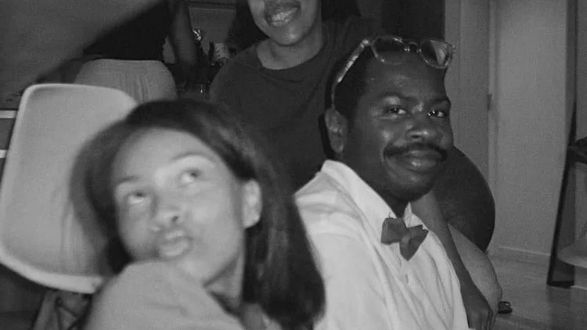
10
Marriage +
Relationships
Healthy churches help people build healthy homes.
PREPARE. STRENGTHEN. RESTORE. CONNECT.
Notes:
[Sources]
- https://v1.church/ - V1 photography.

Slide 42
THE RELATIONAL LANDSCAPE HAS CHANGED
The church must build more than marriage events.
47%
29%
30%
of households are married couples
of households contain one person
of American adults identify as single
30.8
28.4
median first marriage - men
median first marriage - women
Connection is a discipleship issue.
10 / MARRIAGE + RELATIONSHIPS
42
Notes:
[Sources]
- Census 2025: https://www.census.gov/newsroom/press-releases/2025/families-and-living-arrangements.html
- Pew marriage and dating: https://www.pewresearch.org/short-reads/2024/02/08/for-valentines-day-facts-about-marriage-and-dating-in-the-us/
- HHS social connection: https://www.hhs.gov/surgeongeneral/reports-and-publications/connection/index.html

Slide 43
ONE NATIONAL MINISTRY. FOUR RELATIONAL LANES.
V1 Marriage + Relationships
01
PREPARE
Dating, premarital preparation, financial and communication foundations, healthy boundaries.
02
STRENGTHEN
Marriage resources, intensives, groups, parenting and an annual conference.
03
RESTORE
Pastoral support, crisis triage, referrals, separation and divorce care.
04
CONNECT
Singles ministry, friendship, national digital community and healthy local gatherings.
10 / MARRIAGE + RELATIONSHIPS
43
Notes:
[Sources]
- Census 2025: https://www.census.gov/newsroom/press-releases/2025/families-and-living-arrangements.html
- HHS social connection: https://www.hhs.gov/surgeongeneral/reports-and-publications/connection/index.html

Slide 44
“
We will help people become healthy enough to build healthy relationships.
We will not reduce marriage ministry to crisis response.
We will not reduce singles ministry to matchmaking.
We will prepare people before marriage, strengthen them within marriage, walk beside them during crisis, and create places where unmarried adults are deeply known, discipled and connected.
Relationships shape homes, children, leadership, discipleship and the future of the church.
10 / MARRIAGE + RELATIONSHIPS
44
Notes:
[Sources]
- V1OSX Founder-approved operating direction, August 2026.

Slide 45
WHAT V1OSX BRINGS CLOSER
Clarity is not a document. It is distance removed.
Lead Pastor
→
DEPARTMENTS
CMP
→
THE PERSON
Pastors
→
ONLINE CONGREGATION
Staff
→
DEFINING MOMENTS
Sunday
→
PARTICIPATION
Chapel
→
PRACTICE
Relationships
→
EVERYDAY LIFE
V1OSX
45
Notes:
[Sources]
- V1OSX Founder-approved operating direction, August 2026.

Slide 46
V1OSX BEGINS IN MOTION
What happens now.
01
Department meetings enter the Lead Pastor calendar.
05
The 38-40 Sunday preaching calendar is protected.
02
WING pairs carry voice, vision and values between meetings.
06
The Ambassador Pathway and three-Sunday maximum become active.
03
SLS begins with Reveal - the Leadership MRI and annual breakthrough.
07
The single Sunday sequence and Weekly Chapel go live.
04
Regional pastoral ownership returns to V1 Global Online.
08
V1 Marriage + Relationships begins national and local formation.
The remaining implementation detail is worked out while the direction remains clear.
V1OSX
46
Notes:
[Sources]
- V1OSX Founder-approved operating direction, August 2026.

Slide 47
ONE HOUSE.
ONE VOICE.
MANY LEADERS.
CLEAR OWNERSHIP.
V1OSX
THE OPERATING SYSTEM BENEATH THE REVIVAL
Notes:
[Sources]
- V1OSX Founder-approved operating direction, August 2026.

Slide 48
RESEARCH + OPERATING SOURCES
Sources
NASA Space Launch System
nasa.gov/reference/space-launch-system
Hartford Institute - Megachurch Resurgence 2026
hirr.hartfordinternational.edu
Gallup - individualized employee development
gallup.com/workplace/712895
Pew - why Americans attend services
pewresearch.org/religion/2018/08/01
Center for Creative Leadership - self-awareness
ccl.org/leadership-solutions
BLS - multiple jobholders, 2025
bls.gov/cps/cpsaat36.htm
Pew - online religious services
pewresearch.org/religion/2023/06/02
Census - Families and Living Arrangements, 2025
census.gov/newsroom/press-releases/2025
Barna - church technology and mission
barna.com/research/church-technology-mission
HHS - Social Connection Advisory
hhs.gov/surgeongeneral/reports-and-publications/connection
SOURCES
48
Notes:
[Sources]
- NASA Space Launch System
nasa.gov/reference/space-launch-system
- Gallup - individualized employee development
gallup.com/workplace/712895
- Center for Creative Leadership - self-awareness
ccl.org/leadership-solutions
- Pew - online religious services
pewresearch.org/religion/2023/06/02
- Barna - church technology and mission
barna.com/research/church-technology-mission
- Hartford Institute - Megachurch Resurgence 2026
hirr.hartfordinternational.edu
- Pew - why Americans attend services
pewresearch.org/religion/2018/08/01
- BLS - multiple jobholders, 2025
bls.gov/cps/cpsaat36.htm
- Census - Families and Living Arrangements, 2025
census.gov/newsroom/press-releases/2025
- HHS - Social Connection Advisory
hhs.gov/surgeongeneral/reports-and-publications/connection

Slide 49
V1 INTERNAL SOURCES
House documents + observations
WING STRUCTURE
Structure for VI.pdf
STAFF + DEPARTMENTS
V1_Church_Staff_by_Department.pdf
GLOBAL SHEPHERDING
V1 Church Global Regional Shepherding Model.pdf
STAFF PROTOCOL
V1 Church Staff Handbook 2024.pdf
BRAND + PHOTOGRAPHY
v1.church official live site
V1 historical observations in this presentation were supplied by the Founder and are identified as internal observations.
SOURCES
49
Notes:
[Sources]
- /Users/mikesignorelli/Desktop/V1OSX/Structure for VI.pdf
- /Users/mikesignorelli/Downloads/V1_Church_Staff_by_Department.pdf
- /Users/mikesignorelli/Downloads/V1 Church Global Regional Shepherding Model.pdf
- /Users/mikesignorelli/Downloads/05 — Staff Handbook and HR Policies/V1 Church Staff Handbook 2024.pdf
- https://v1.church/

